Slide 1

Kubernetes and Service Mesh Workshop- VMware

Slide 2
- Breakfast will be served until 9:30 AM - Please ensure you have registered for the Labs and have a token with a cluster assigned to you
Kubernetes and Service Mesh Workshop

Slide 3


Agenda
9:00 AM – 9:30 AM | Registrations + Breakfast
9:30 AM -10:45 AM | Kubernetes Concepts + Initial Setup Lab 1 &2
10:45 AM – 11:00 AM | Break + Coffee
11:00 AM – 12:00 PM | Introduction to Service Mesh and Istio +Lab3
12:OO PM – 1:00 PM | Lunch
1:00 PM – 2:00 PM | Integrating a Service mesh with existing applications + Lab4
2:00 PM – 3:00 PM | Service Mesh Use case 1: Traffic Management+ Lab5
3:00 PM – 3:30 PM | Break
3:30 PM – 4:15 PM | Service Mesh Use case 2: Canary Upgrades + Lab 6
4:15 PM – 5:00 PM | Istio Use case 3: Application Tracing with Jaeger + Lab 7

Slide 4
Speakers
Alicja Gilderdale
Staff Systems Engineer, Cloud Native
Shriram Rajagopalan
Staff Engineer
Contributor Istio, Envoy
Boskey Savla
Technical Product Marketing Manager

Slide 5
Kubernetes Concepts

Slide 6
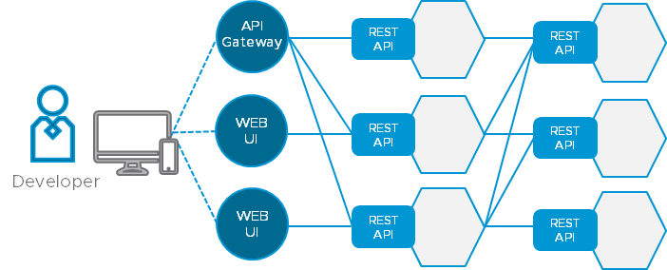
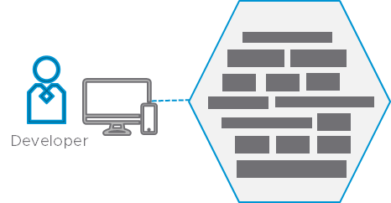
Modern Applications are based on Distributed Microservices
API
Gateway
REST API
REST API
WEB
UI
REST API
REST API
Developer
Developer
WEB
UI
REST API
REST API
Monoliths
Single, large code base
Slower to update, scale
Runs in VMs or containers
Microservices
Small, modular code base
Easier to update, scale
Runs in containers
Notes:
Microservices Architecture:
It’s really the microservices architecture that allows for that rapid evolution, scalability and availability of applications. Modern applications are based on distributed microservice. A microservice is a modular piece of a larger application. For example, a payments function of an application could be considered a microservice. Microservices are small pieces of code (small application components) that have well defined interfaces (APIs)
From monoliths to microservices
It used to be that applications were built as monoliths, but unfortunately, monoliths tend to not scale very well and often also have availability issues. An example is Twitter. You used to hear about Twitter outages every time there was a big celebrity event where lots of people tweeting. You don’t hear about that anymore. It’s because Twitter adopted a new way of architecting their application: Microservices.
Benefits and Key Features of Microservices Architecture
It’s a way of architecting applications for scalability, availability and robustness. If you’re counting on your applications as a primary driver of revenue, it’s important to have your application available 24/7 and microservices are a great way of ensuring that. Microservices ensure modularity, scalability, speed, and high availability.
First, modularity: The code is broken down into small chunks that have a well-defined interface, usually defined by an API.
This allows for speed, by enabling you to evolve one module at a time. Instead of having very long release cycles, you can be continuously releasing new bits of code that evolve the application.
Third, scalability: Now you can selectively scale out different pieces of the application, making it much more flexible for demand spikes.
And finally, availability, as you distribute the application with the microservices, you are putting it over more and more pieces of infrastructure. If any one of those pieces of infrastructure fail, it's no longer significant, because you’re maintaining availability at the application layer and because you’re spread out across so many different pieces of infrastructure, you can heal and repair quickly.
Enter Complexity The benefits of using microservices are clear, but if you think about it this actually introduces a significant amount of complexity. From one monolith, you now have 100 different pieces, which all have to be inter-networked, you have to worry about the security of all the different pieces, and it introduces a large amount of complexity in terms of orchestrating and managing all these different pieces as one unified whole.

Slide 7
From Monolith to Microservices
VM
VM
Service 1
Conrtainer 1
Conrtainer 2
Conrtainer 3
Service 2
Service 3
App 1
App 2
App 3
Bins/Libs
Bins/Libs
Bins/Libs
Bins/Libs
OS
Container Engine
OS
Hypervisor
Hypervisor
Infrastructure
Infrastructure
Virtual Machines
Containers
Notes:
Narrative: Containers are abstracting the OS like what VMs did to hardware

Slide 8
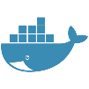
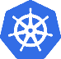
Container vs Container Orchestration
Basic Containers
One at a Time
Container Orchestration
Orchestrating Multiple Containers
Core Docker functionality is ability run containers
Manual, no fault tolerance, hard to scale, etc
Scheduling, provisioning, and resource management of multiple containers
Docker, Mesos → Kubernetes Support
AWS, Azure, Google → Kubernetes Services
The “App”
$docker run container1
$kubctl create –f App.yaml
Wanted:
Container Orchestrator!
$docker run container1
The “App”
$docker run container2
$docker run container3
Kubernetes Cluster
Notes:
3min
Docker containers alone are not the end game. They help with architecting the application components, but they do not address operating them at scale. Kubernetes has emerged as the defacto container orchestrator as every major container technology company is supporting it
Google has won with k8s.

Slide 9
Challenges with Containers in Production
CONTAINERS IN
PRODUCTION
CONTAINERS IN
DEVELOPMENT
Load Balancing
Security
COMPLEXITY
High Availability
Application Updates
STEEP LEARNING CURVE
Scaling up/down
Repeatable Deployments
Replication
Scheduling
PROJECT DELIVERY TIME
Containers
Containers
Notes:
3min
Docker containers alone are not the end game. They help with architecting the application components, but they do not address operating them at scale. Kubernetes has emerged as the defacto container orchestrator as every major container technology company is supporting it
Google has won with k8s.

Slide 10
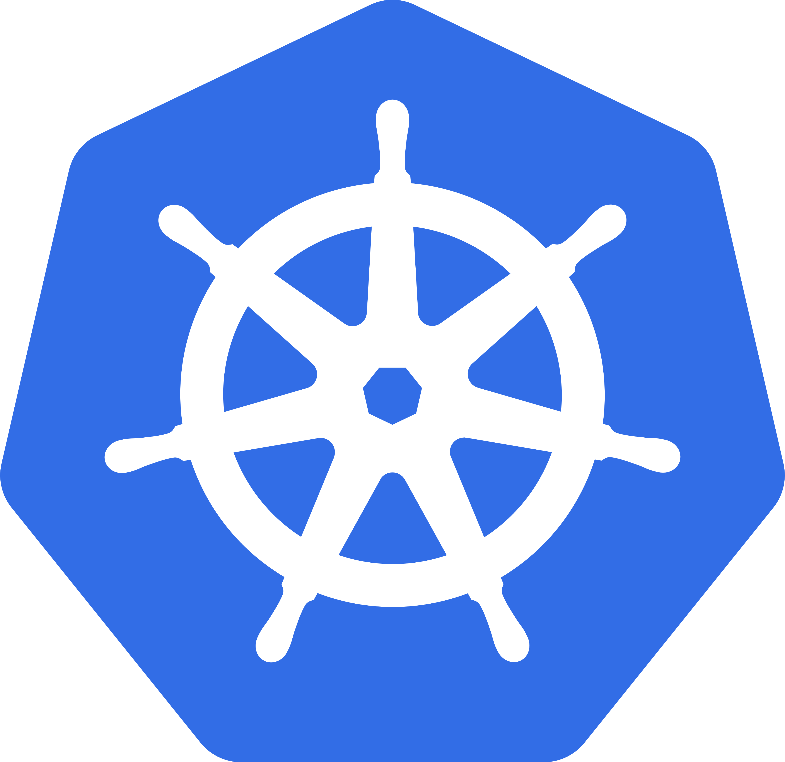
What is Kubernetes - Overview
Kubernetes is an open-source system for automating deployment, scaling and management of containerized applications.
Major Features
Deploy applications quickly and predictably
Scale applications on the fly
Roll out new features seamlessly
Optimize use of hardware
Restart, replace and reschedule containers
Node
Notes:
Narrative: Containers are abstracting the OS like what VMs did to hardware

Slide 11
Kubernetes 101 at the Highest Level
P1R1
P2R1
P2R1
P1R1
Worker Node
(Container Host)
App_X.yaml
ContainerImage1
Replicas: 3
ContainerImage2
Replicas: 2
K
Kubernetes Cluster Services
(Master & etcd nodes)
App_Y.yaml
ContainerImage1
Replicas: 1
ContainerImage2
Replicas: 2
API
P1R2
P2R1
P1R1
Worker Node
(Container Host)
K
P1R3
P2R2
P2R2
P1R2
Worker Node
(Container Host)
K
11

Slide 12

Logical Kubernetes Architecture
K8s Master
ETCD
Controller Manager
Kube Scheduler
API Server
K8s Worker
K8s Worker
K8s Worker
Kubelet
POD
Kubelet
POD
Kubelet
POD
POD
POD
POD
POD
POD
POD
Kube-proxy
POD
Kube-proxy
POD
Kube-proxy
POD
CNI
CNI
CNI

Slide 13
Kubernetes Objects (Resource Types)
Component | Description
Pods | A grouping of one or more containers as an atomic unit
Namespaces | A way to organize items in a cluster (+ RBAC)
Labels, Annotations & Selectors | Tags for component grouping and methods to access them
Service Discovery | An object associated to a label selector to provide a LB and Service DNS
ReplicaSets | A cluster wide Pod manager providing Pod scaling
DaemonSets | A Pod manager to ensure a Pod is scheduled across a Cluster Node set
StatefulSets | Replicated Pods where each Pod gets an indexed hostname
Jobs | A Pod which runs until the process returns a successful termination
Deployments | Manages the release rollout of new versions of Pods

Slide 14
Architecting with Specific Application Requirements
Common
App Dev architects with native Kubernetes constructs
AppDev
ELK
Spark
N^{th} App
K8s API
Kubernetes Cluster
Security Policy
Storage Requirements
PRE Role
Focus on mapping Kubernetes constructs to a given infrastructure
Availability Zone
Load Balancer
Application Metrics
Infrastructure
Compute
Network
Monitoring
PRE
Security
Storage

Slide 15
Networking

Slide 16
Containers Network
eth0
10.100.0.2
Physical Network Interface
docker0
172.17.0.1
Docker0 Bridge
veth0
172.17.0.2
veth1
172.17.0.3
Virtual Network Interface
Container 1
Container 2
Worker Node
Ref: https://medium.com
Notes:
A pod consists of one or more containers that are collocated on the same host, and are configured to share a network stack and other resources such as volumes. Pods are the basic unit kubernetes applications are built from. What does “share a network stack” actually mean? In practical terms it means that all the containers in a pod can reach each other on localhost. If I have a container running nginx and listening on port 80 and another container running scrapyd the second container can connect to the first as http://localhost:80. But how does that really work? Lets look at the typical situation when we start a docker container on our local machine:
From the top down we have a physical network interface eth0. Attached to that is a bridge docker0, and attached to that is a virtual network interface veth0. Note that docker0 and veth0 are both on the same network, 172.17.0.0/24 in this example. On this network docker0 is assigned 172.17.0.1 and is the default gateway for veth0, which is assigned 172.17.0.2. Due to how network namespaces are configured when the container is launched processes inside it see only veth0, and communicate with the outside world through docker0 and eth0. Now let’s launch a second container:
As shown above the second container gets a new virtual network interface veth1, connected to the same docker0 bridge.* This interface is assigned 172.17.0.3, so it is on the same logical network as the bridge and the first container, and both containers can communicate through the bridge as long as they can discover the other container’s IP address somehow.
[ * Dan Nissenbaum pointed out that this description omits some detail. For background see our brief discussion at the end of the post. In reality a TAP interface is created in the host network stack and attached to the bridge, and then a virtual interface is created in the container namespace and paired with the TAP interface. For a deeper discussion see http://www.innervoice.in/blogs/2013/12/02/linux-bridge-virtual-networking/ as well as http://www.innervoice.in/blogs/2013/12/08/tap-interfaces-linux-bridge/ ]
That’s fine and all but it doesn’t get us to the “shared network stack” of a kubernetes pod. Fortunately namespaces are very flexible. Docker can start a container and rather than creating a new virtual network interface for it, specify that it shares an existing interface. In this case the drawing above looks a little different:

Slide 17
Containers Network
Kubernetes does not align IP addressing with Namespaces
The node maintains a unique IP address range for its pods
Each pod gets an IP from this range
eth0
10.100.0.2
docker0
172.17.0.1
pause
veth0
172.17.0.2
Virtual Network Interface shared across containers
Container 1
Container 2
Worker Node
Ref: https://medium.com
Notes:
Now the second container sees veth0 rather than getting its own veth1 as in the previous example. This has a few implications: first, both containers are addressable from the outside on 172.17.0.2, and on the inside each can hit ports opened by the other on localhost. This also means that the two containers cannot open the same port, which is a restriction but no different than the situation when running multiple processes on a single host. In this way a set of processes can take full advantage of the decoupling and isolation of containers, while at the same time collaborating together in the simplest possible networking environment.
Kubernetes implements this pattern by creating a special container for each pod whose only purpose is to provide a network interface for the other containers. If you ssh in to a kubernetes cluster node that has pods scheduled on it and run docker ps you will see at least one container that was started with the pause command. The pause command suspends the current process until a signal is received so these containers do nothing at all except sleep until kubernetes sends them a SIGTERM. Despite this lack of activity the “pause” container is the heart of the pod, providing the virtual network interface that all the other containers will use to communicate with each other and the outside world. So in a hypothetical pod-like thing the last picture sort of looks like this:

Slide 18
Pods Network (Overlay Network)
Destination next hop
10.0.1.0/24 10.100.0.2
10.0.2.0/24 10.100.0.3
Combination of virtual network interfaces, bridges, and routing rules is called an Overlay Network
Router/Gateway
10.100.0.1
eth0
10.100.0.2
eth0
10.100.0.3
cbr0
10.0.1.1
cbr0
10.0.2.1
Custom Bridge
pause
pause
veth0
172.17.0.2
veth0
172.17.0.2
Container 1
Container 2
Container 1
Container 2
Worker Node
Worker Node
Ref: https://medium.com
Notes:
The Pod Network
That’s all pretty cool, but one pod full of containers that can talk to each other does not get us a system. For reasons that will become even clearer in the next post where I discuss services, the very heart of kubernetes’ design requires that pods be able to communicate with other pods whether they are running on the same local host or separate hosts. To look at how that happens we need to step up a level and look at nodes in a cluster. This section will contain some unfortunate references to network routing and routes, a subject I realize all of humanity would prefer to avoid. Finding a clear, brief tutorial on IP routing is difficult, but if you want a decent review wikipedia’s article on the topic isn’t horrible.
A kubernetes cluster consists of one or more nodes. A node is a host system, whether physical or virtual, with a container runtime and its dependencies (i.e. docker mostly) and several kubernetes system components, that is connected to a network that allows it to reach other nodes in the cluster. A simple cluster of two nodes might look like this:
If you’re running your cluster on a cloud platform like GCP or AWS that drawing pretty well approximates the default networking architecture for a single project environment. For the purposes of illustration I’ve used the private network 10.100.0.0/24 for this example, so the router is 10.100.0.1 and the two instances are 10.100.0.2 and 10.100.0.3 respectively. Given this setup each instance can communicate with the other on eth0. That’s great, but recall that the pod we looked at above is not on this private network: it’s hanging off a bridge on a different network entirely, one that is virtual and exists only on a specific node. To make this clearer let’s drop our pod-like things back into the picture:
The host on the left has interface eth0 with an address of 10.100.0.2, whose default gateway is the router at 10.100.0.1. Connected to that interface is bridge docker0 with an address of 172.17.0.1, and connected to that is interface veth0 with address 172.17.0.2. The veth0 interface was created with the pause container and is visible inside all three containers by virtue of the shared network stack. Because of local routing rules set up when the bridge was created any packet arriving at eth0 with a destination address of 172.17.0.2 will be forwarded to the bridge, which will then send it on to veth0. Sounds ok so far. If we know we have a pod at 172.17.0.2 on this host we can add rules to our router setting the next hop for that address to 10.100.0.2 and they will get forwarded from there to veth0. Dandy! Now let’s look at the other host.

Slide 19
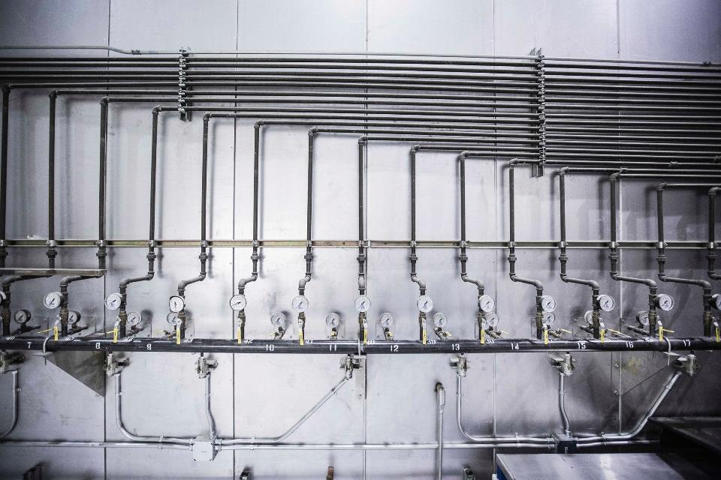
Services
Notes:
Services

Slide 20
Publishing Services – K8s Service Types
Service defines a logical set of Pods and a policy by which to access them.
Service in Kubernetes is a REST object, similar to a Pod.
Service Types:
Cluster IP
NodePort
LoadBalancer
ExternalName
Notes:
3min
Docker containers alone are not the end game. They help with architecting the application components, but they do not address operating them at scale. Kubernetes has emerged as the defacto container orchestrator as every major container technology company is supporting it
Google has won with k8s.

Slide 21
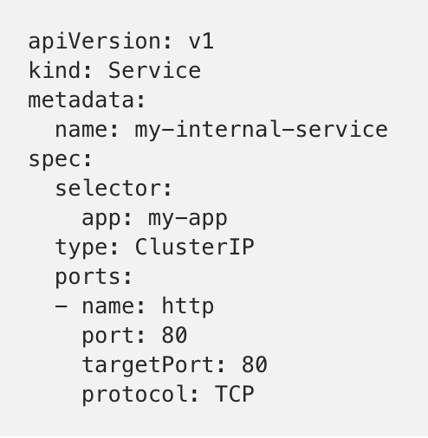
K8s Service Types - ClusterIP
Cluster IP provides service within the Cluster.
No external access.
Traffic
http://localhost:8080/api/v1/proxy/namespaces/default/services/my-internal-service:http/
Proxy
Service
(Internal Cluster IP)
app=my-app
Port 80
Port 80
Port 80
app=my-app
app=my-app
app=my-app
POD
POD
POD
K8s Cluster
Ref: https://medium.com
Notes:
ClusterIP
A ClusterIP service is the default Kubernetes service. It gives you a service inside your cluster that other apps inside your cluster can access. There is no external access.
Start the Kubernetes Proxy:
$ kubectl proxy --port=8080Now, you can navigate through the Kubernetes API to access this service using this scheme:
http://localhost:8080/api/v1/proxy/namespaces/<NAMESPACE>/services/<SERVICE-NAME>:<PORT-NAME>/
So to access the service we defined above, you could use the following address:
http://localhost:8080/api/v1/proxy/namespaces/default/services/my-internal-service:http/
When would you use this?
There are a few scenarios where you would use the Kubernetes proxy to access your services.
Debugging your services, or connecting to them directly from your laptop for some reason
Allowing internal traffic, displaying internal dashboards, etc.
Because this method requires you to run kubectl as an authenticated user, you should NOT use this to expose your service to the internet or use it for production services.

Slide 22
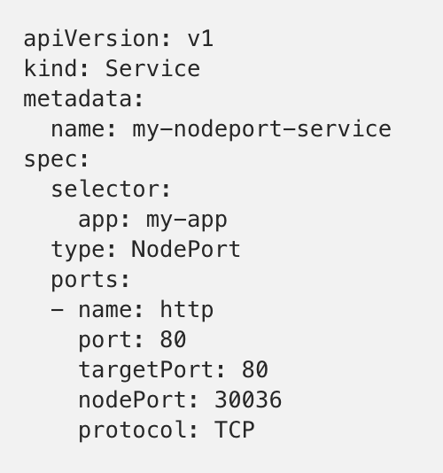
K8s Service Types - NodePort
NodePort provides external traffic directly to the service. Opens a specific port on all the Nodes
K8s Cluster
Service
Port 80
Port 80
Port 80
app=my-app
app=my-app
app=my-app
POD
POD
POD
VM
VM
VM
Port
30036
Port
30036
Port
30036
Traffic
Ref: https://medium.com
Notes:
A NodePort service is the most primitive way to get external traffic directly to your service. NodePort, as the name implies, opens a specific port on all the Nodes (the VMs), and any traffic that is sent to this port is forwarded to the service.
Basically, a NodePort service has two differences from a normal “ClusterIP” service. First, the type is “NodePort.” There is also an additional port called the nodePort that specifies which port to open on the nodes. If you don’t specify this port, it will pick a random port. Most of the time you should let Kubernetes choose the port; as thockin says, there are many caveats to what ports are available for you to use.
When would you use this?
There are many downsides to this method:
You can only have once service per port
You can only use ports 30000–32767
If your Node/VM IP address change, you need to deal with that
For these reasons, I don’t recommend using this method in production to directly expose your service. If you are running a service that doesn’t have to be always available, or you are very cost sensitive, this method will work for you. A good example of such an application is a demo app or something temporary.

Slide 23
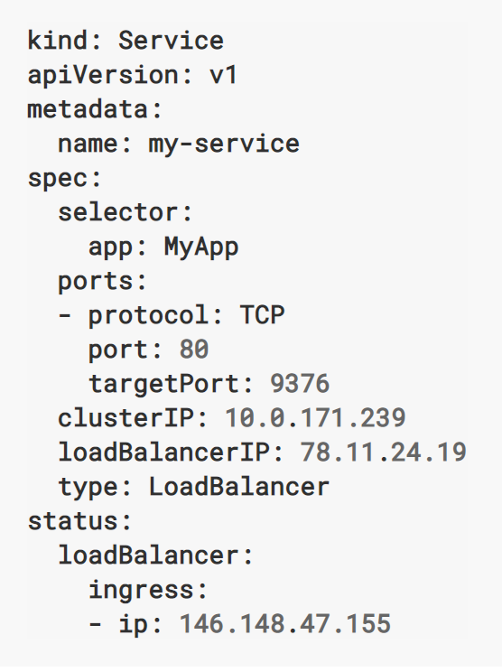
K8s Service Types - LoadBalancer
LoadBalancer is standard way to expose a service to the internet.
It allocates single IP that will forward traffic to the service.
Traffic
http 80
LoadBalancer
(external IP)
Service
app=MyApp
Port 80
Port 80
Port 80
app=MyApp
app=MyApp
app=MyApp
POD
POD
POD
K8s Cluster
Notes:
A LoadBalancer service is the standard way to expose a service to the internet. On GKE, this will spin up a Network Load Balancer that will give you a single IP address that will forward all traffic to your service.
When would you use this?
If you want to directly expose a service, this is the default method. All traffic on the port you specify will be forwarded to the service. There is no filtering, no routing, etc. This means you can send almost any kind of traffic to it, like HTTP, TCP, UDP, Websockets, gRPC, or whatever.
The big downside is that each service you expose with a LoadBalancer will get its own IP address, and you have to pay for a LoadBalancer per exposed service, which can get expensive!

Slide 24
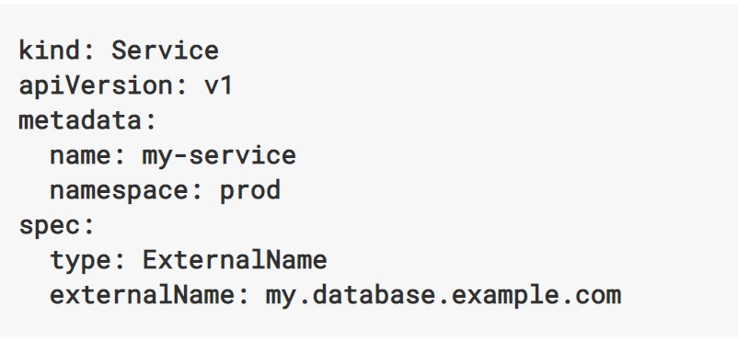
K8s Service Types - ExternalName
ExternalName maps the service to the contents of the externalName field
i.e. my.database.example.com
Notes:
3min
Docker containers alone are not the end game. They help with architecting the application components, but they do not address operating them at scale. Kubernetes has emerged as the defacto container orchestrator as every major container technology company is supporting it
Google has won with k8s.

Slide 25
K8s Service Discovery
Kubernetes supports 2 primary modes of finding a Service:
DNS
The DNS server watches the Kubernetes API for new Services and creates a set of DNS records for each. If DNS has been enabled throughout the cluster then all Pods should be able to do name resolution of Services automatically
Environmental Variables
When a Pod is run on a Node, the kubelet adds a set of environment variables for each active Service
Notes:
3min
Docker containers alone are not the end game. They help with architecting the application components, but they do not address operating them at scale. Kubernetes has emerged as the defacto container orchestrator as every major container technology company is supporting it
Google has won with k8s.

Slide 26
Ingress

Slide 27
Ingress – NOT a service type
http or https traffic
http://breakfast.com
K8s Cluster
Ingress
http://breakfast.com/bacon
http://breakfast.com/eggs
Service
app=bacon
Service
app=eggs
Port 80
Port 80
Port 80
Port 80
Port 80
Port 80
app=bacon
app=bacon
app=bacon
app=eggs
app=eggs
app=eggs
POD
POD
POD
POD
POD
POD
Notes:
Ingress it’s NOT a service type.
It sits in front of multiple services and act as a “smart router” or entrypoint into the cluster.
Can be configured to give services externally-reachable URLs, load balance traffic, terminate SSL, and offer name based virtual hosting
Ingress extends that even further to add SSL and layer 7 based load balancing such as name-based virtual hosts.

Slide 28
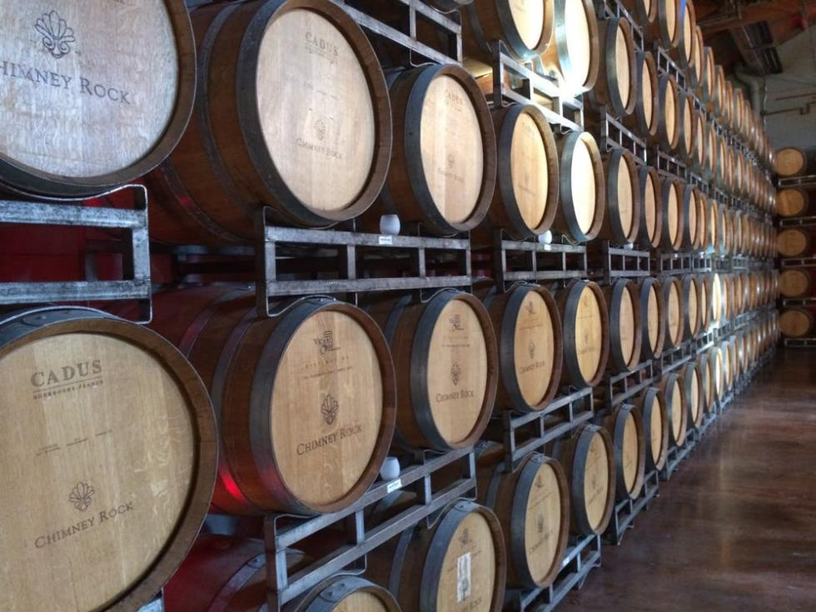
Volume
Notes:
Volumes

Slide 29
Persistent Volumes
Volume is [effectively] a Directory, possibly with data in it, available to all containers in a Pod.
Usually Shares lifecycle of a Pod (Created when Pod is created, destroyed when Pod is destroyed).
Persistent Volumes outlive Pods.
Can be mounted from local disk, or from a network storage device such as a vSphere Datastore, iSCSI, NFS, etc.
Container
Container
Pod
Notes:
3min
Docker containers alone are not the end game. They help with architecting the application components, but they do not address operating them at scale. Kubernetes has emerged as the defacto container orchestrator as every major container technology company is supporting it
Google has won with k8s.

Slide 30

K8s Service Discovery
K8s API
Kubernetes Worker (VM)
New Pod
K8s vSphere Cloud provider
Kubelet
Create Storage Class
Pod
Redis
DB
Name: thin-disk
Provisioner: vSphere Volume
Diskformat: thin
Redis
DB
K8s Vol
Tools, Libs, SW
Tools, Libs, SW
Create Persistent Vol Claim
Name: volume-claim
Storage class: thin-disk
Accessmode: readwrite
Storage: 2GB
vSphere
vCenter
Create Pod and Mount Volume
Datastore1
Podspec includes:
Persistent volume claim
Filesystem mount point
dataVol.vmdk
Notes:
3min
Docker containers alone are not the end game. They help with architecting the application components, but they do not address operating them at scale. Kubernetes has emerged as the defacto container orchestrator as every major container technology company is supporting it
Google has won with k8s.

Slide 31

Migrating App

Slide 32
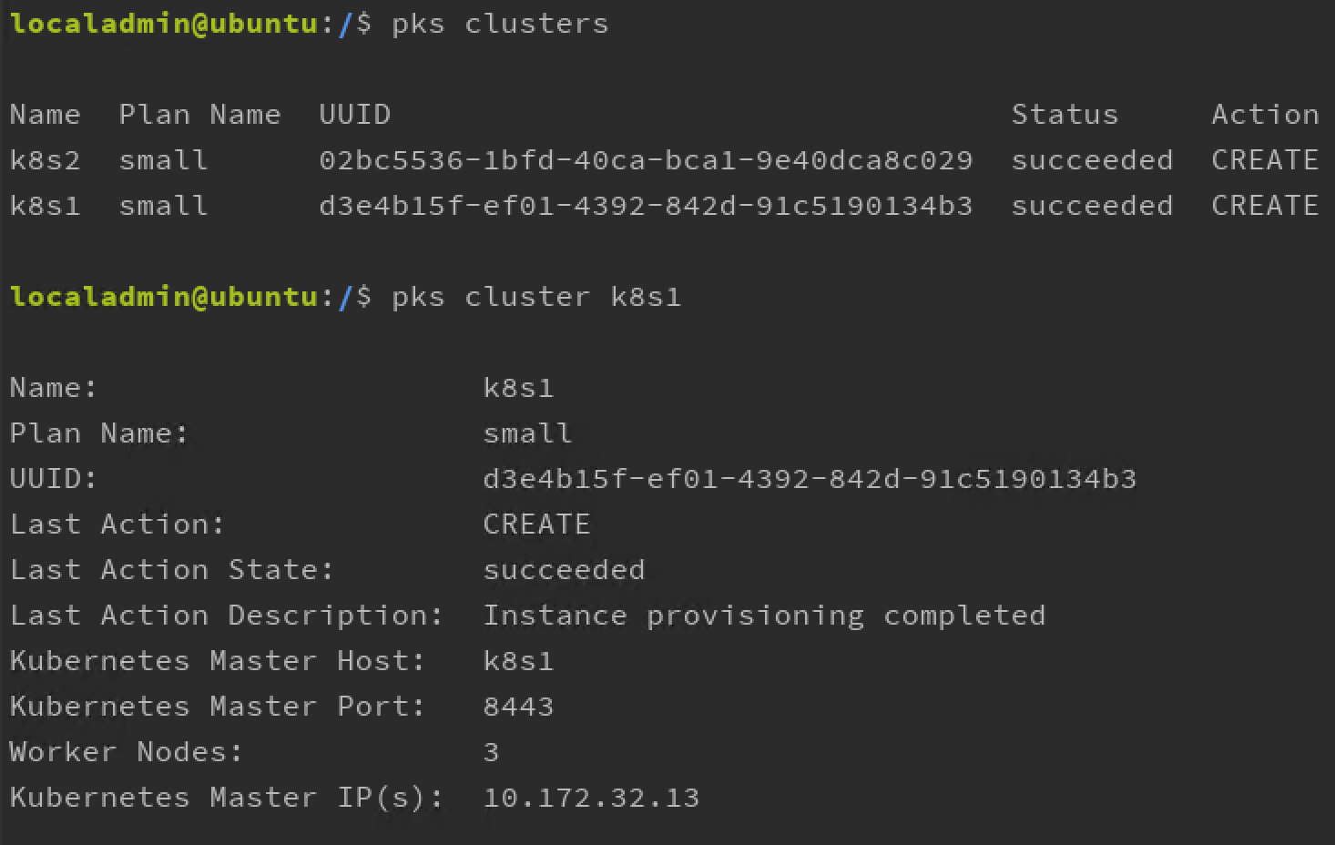
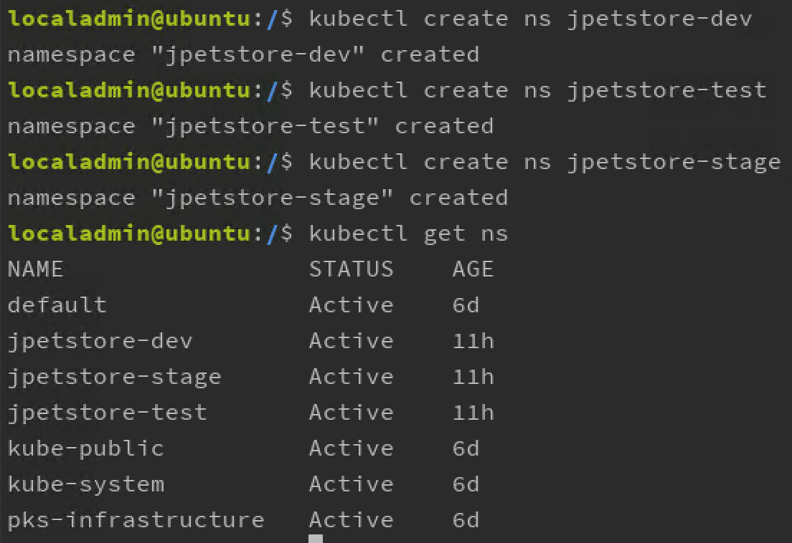
Prepare K8s environments
Notes:
Narrative: Containers are abstracting the OS like what VMs did to hardware

Slide 33
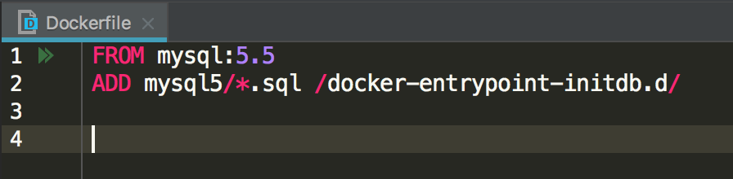
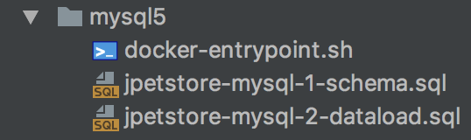
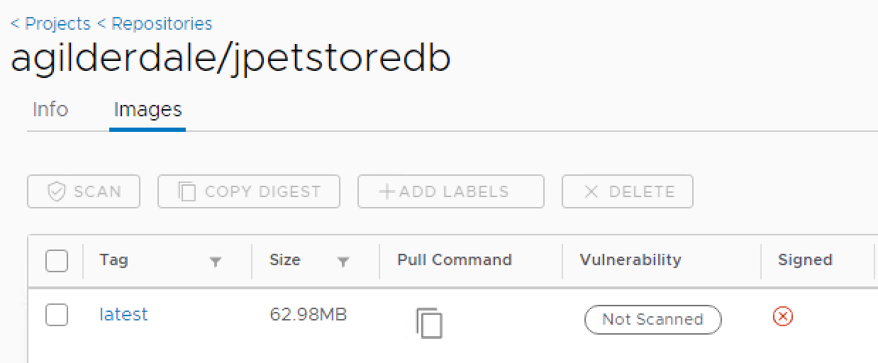
Containerize Database
$ docker build . -t harbor.lab.local/agilderdale/jpetstoredb
$ docker push harbor.lab.local/agilderdale/jpetstoredb
Notes:
Narrative: Containers are abstracting the OS like what VMs did to hardware

Slide 34
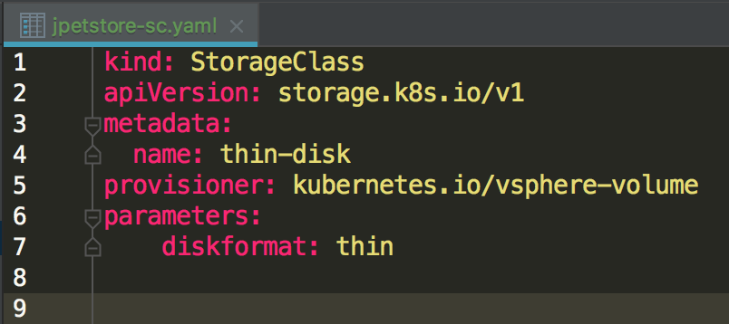
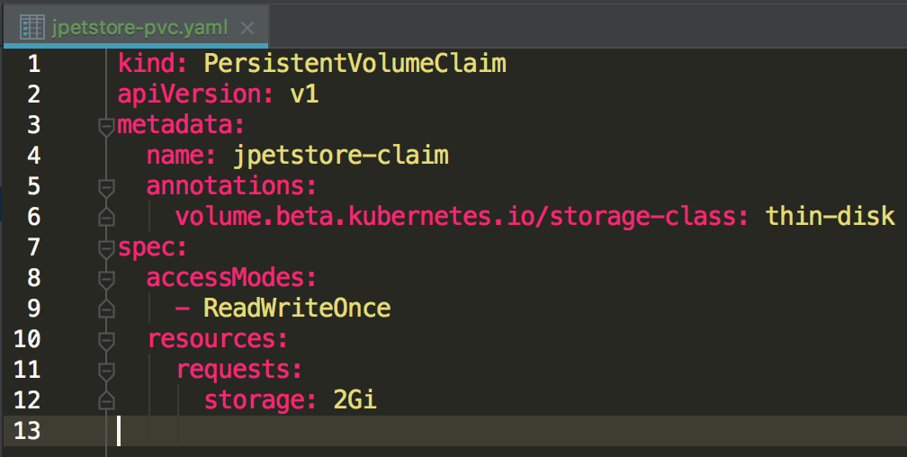
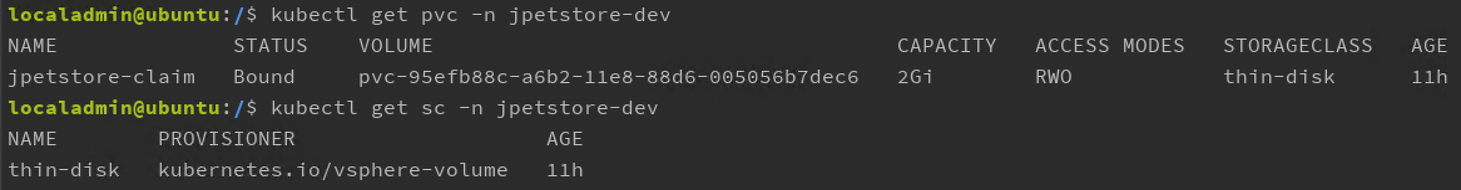
Create persistent storage
$ kubectl create -n jpetstore-dev -f jpetstore-sc.yaml
$ kubectl create -n jpetstore-dev -f jpetstore-pvc.yaml
Notes:
Narrative: Containers are abstracting the OS like what VMs did to hardware

Slide 35
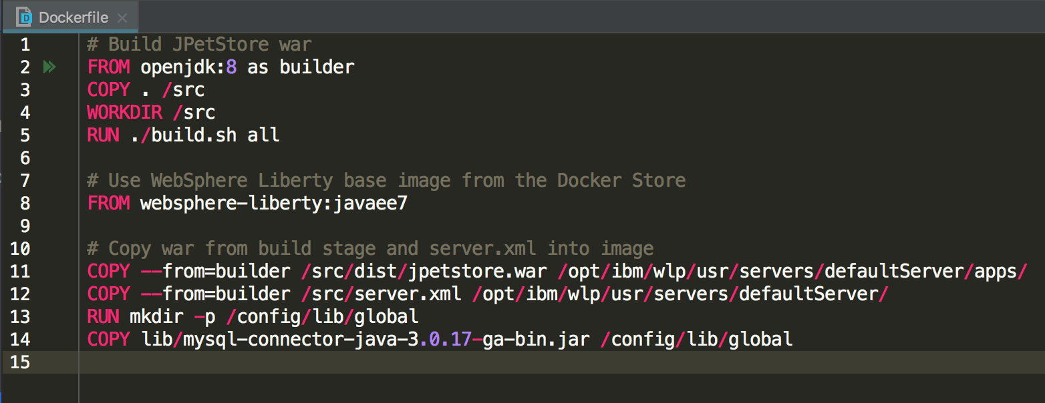
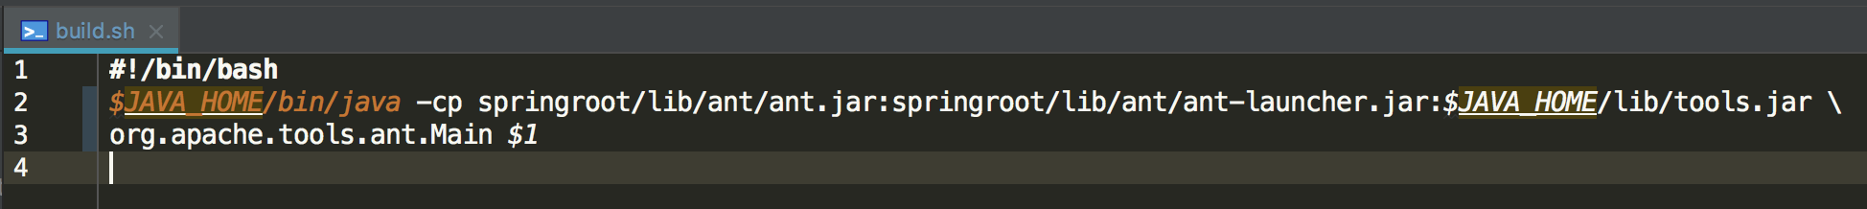
Create Application Dockerfile
Notes:
Narrative: Containers are abstracting the OS like what VMs did to hardware

Slide 36
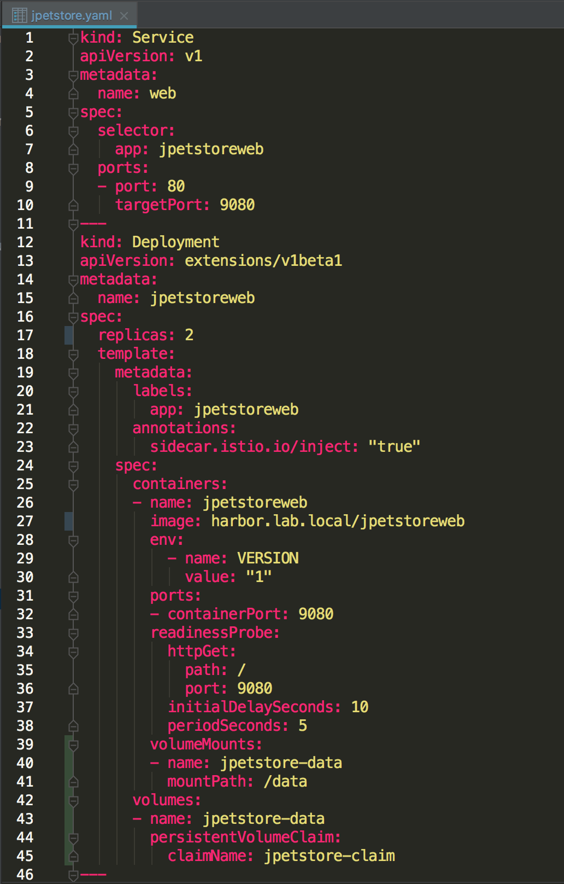
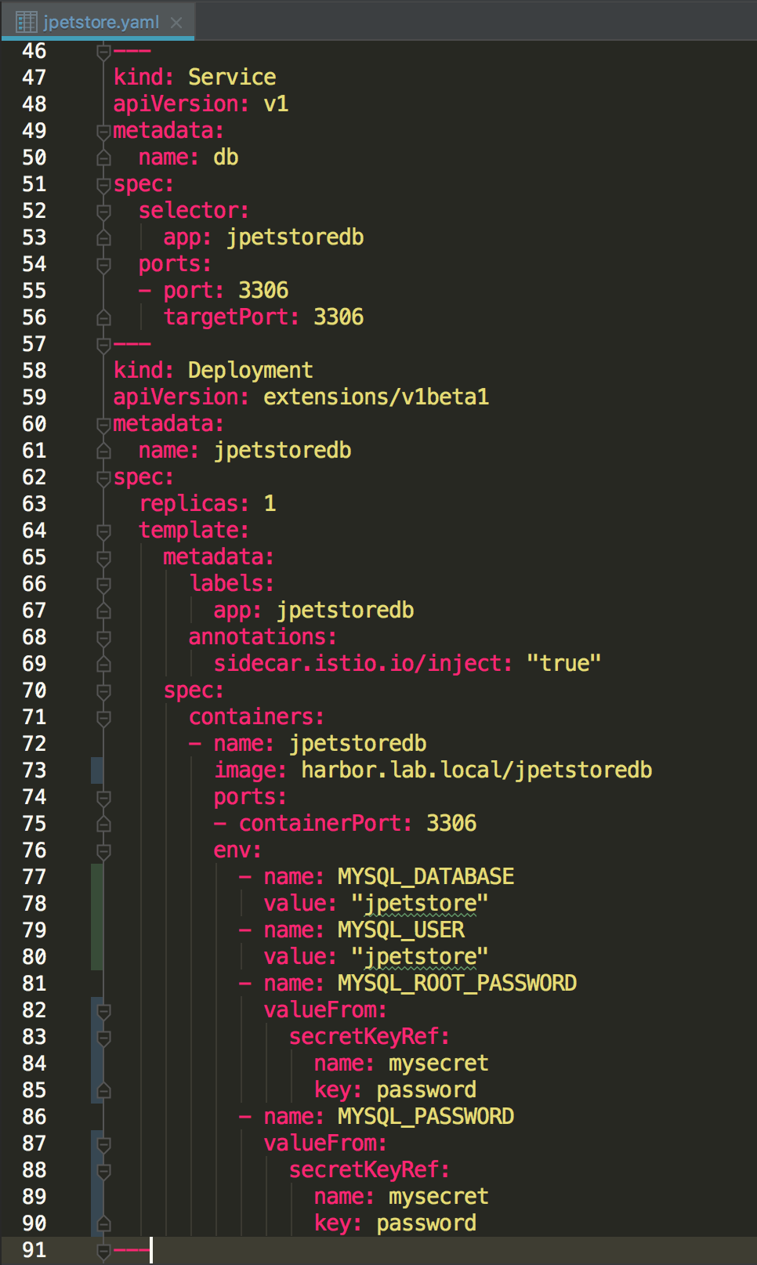
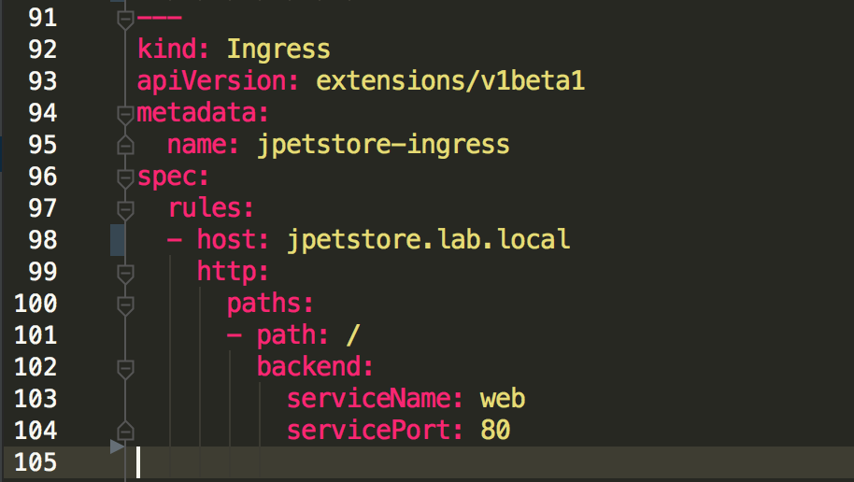
Create K8s Deployment YAML
Notes:
Narrative: Containers are abstracting the OS like what VMs did to hardware

Slide 37
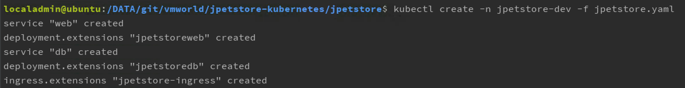
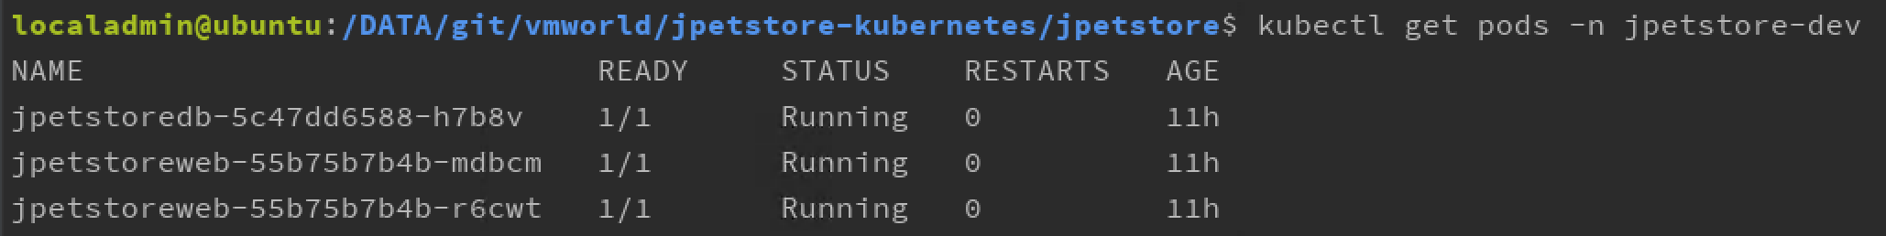
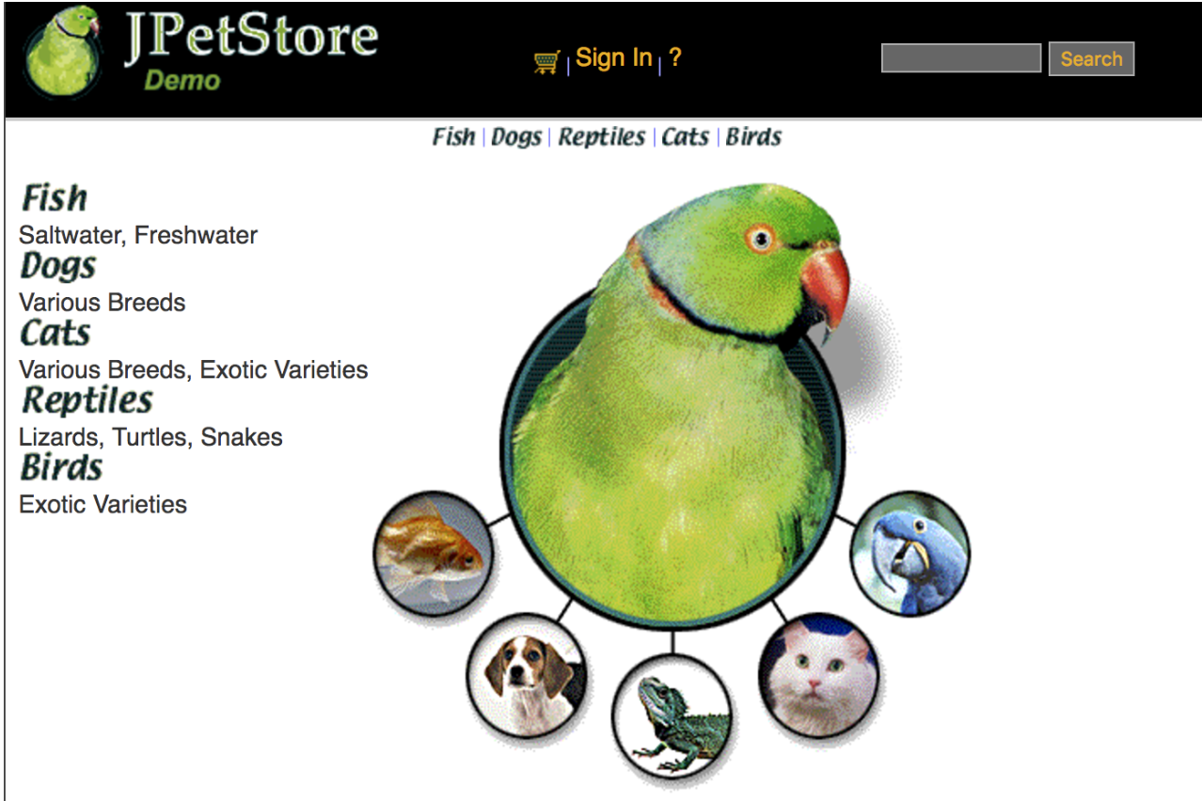
Deploy to K8s Namespace
Notes:
Narrative: Containers are abstracting the OS like what VMs did to hardware

Slide 38
Lab1 & 2 : Access Cluster and Deploy Planespotter App http://bit.ly/Kube18_servicemesh_vmw

Slide 39
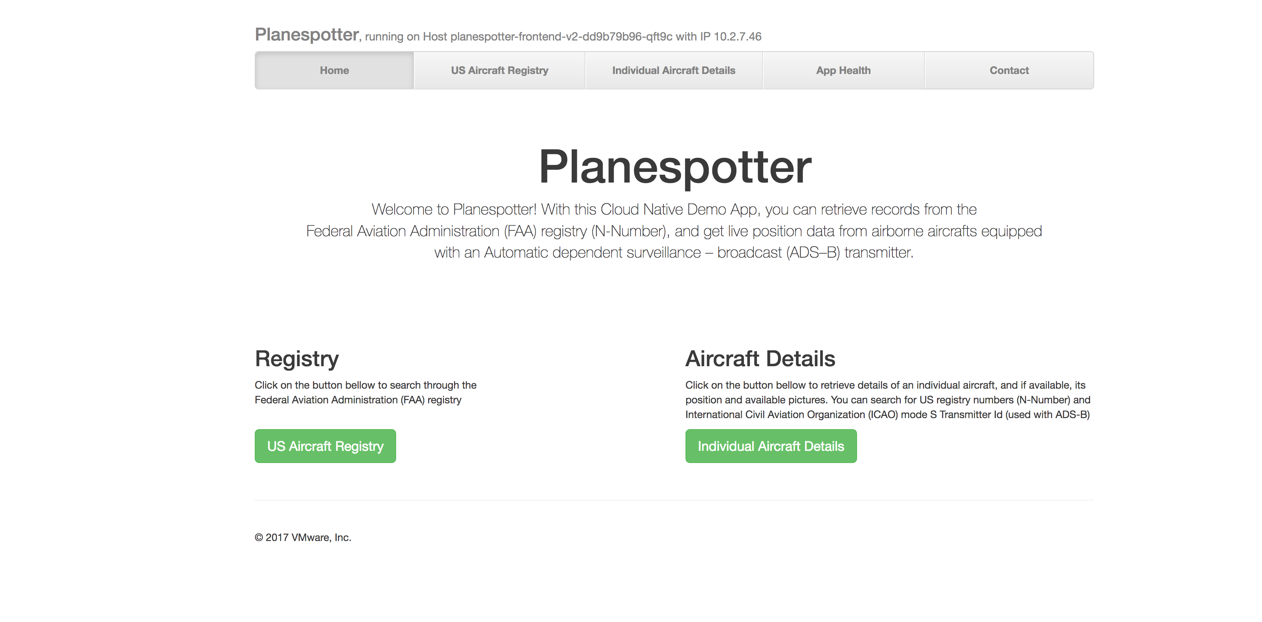
Demo App: “Planespotter"

Slide 40

Planespotter App
Frontend
API Server
Redis Server
MySQL
UI Interface
Pulls data from Redis and MySQl DB
Redis: In memory data for flights airborne
MySQL: Aircraft registration data
Load Balancer = Service
Frontend LB
Service= Pod Labels
Frontend
App-server
Redis
MySQl
Pods
{Labels: frontned, app-server, redis, MySQl}
Frontend
App-server
Redis
MySQl

Slide 41
Overview of Exercises
Step 1
Access Kubernetes Cluster
Complete registration for VMware Kubernetes Engine
Step 2
Setup Config to use CLI
Complete instructions for Setting up VKE CLI and Kubectl in the Lab guide
Step 3
Deploy ‘Planespotter’ app
Complete instructions for deploying planespotter in the Lab guide
Step 4
Publish ‘Planespotter’ app
Complete instructions for Publishing planespotter in the Lab guide

Slide 42
Istio Introduction

Slide 43

Istio
A modern service mesh

Slide 44

Present the problems we’re trying to solve
Very brief architectural overview
Status
Service Mesh
???

Slide 45
Elevate the network to the needs of applications
Uniform observability regardless of platform
Security by default, everywhere

Slide 46
try {
HttpResponse response = httpClient.get(
“http://secretsauce.internal/recipe”);
cook(response.body);
} catch (NetworkError ne) {
fixmePleaseOMG(ne);
}
Notes:
This is the code the application developer wants to write.
We have to acknowledge that things will fail on the network - no fallacies here
Want that call to be reliable - nines please
How do we get it there today?

Slide 47
try {
// Load balancing
IP ip = DNS.lookupSRV(“secretsauce.internal”).pickOne();
HttpResponse response = httpClient.open(ip).get(
“http://secretsauce.internal/recipe”);
cook(response.body);
} catch (NetworkError ne) {
fixmePleaseOMG(ne);
}
Notes:
Lets add some load balancing…
Regionality
Healthc checking

Slide 48
for (int i = 0; i < 3; i++) { // Retry
try {
IP ip = DNS.lookupSRV(“secretsauce.internal”).pickOne();
HttpResponse response = httpClient.open(ip).get(
“http://secretsauce.internal/recipe”);
cook(response.body);
} catch (NetworkError ne) {
if (i == 2) fixmePleaseOMG(ne);
else Thread.sleep(random(5) * 1000);
}
}
Notes:
This is the code the application developer wants to write.
We have to acknowledge that things will fail on the network - no fallacies here
Want that call to be reliable - nines please
How do we get it there today?
animations

Slide 49
Secret key = new Secret(new File(“/somewhere/safe/key”);
for (int i = 0; i < 3; i++) {
try {
IP ip = DNS.lookupSRV(“secretsauce.internal”).pickOne();
HttpResponse response = httpClient.open(ip)
.setHeader(“Authorization”, key.toString())
.get(“http://secretsauce.internal/recipe”);
cook(response.body);
} catch (NetworkError ne) {
if (i == 2) fixmePleaseOMG(ne);
else Thread.sleep(random(5) * 1000);
}
}
Notes:
This is the code the application developer wants to write.
We have to acknowledge that things will fail on the network - no fallacies here
Want that call to be reliable - nines please
How do we get it there today?
animations

Slide 50
Secret key = new Secret(new File(“/somewhere/safe/key”);
for (int i = 0; i < 3; i++) {
try {
IP ip = DNS.lookupSRV(“secretsauce.internal”).pickOne();
HttpResponse response = httpClient.open(ip)
.setHeader(“Authorization”, key.toString())
.get(“http://secretsauce.internal/recipe”);
log(“Success”);
cook(response.body);
} catch (NetworkError ne) {
log(“Failed”);
if (i == 2) fixmePleaseOMG(ne);
else Thread.sleep(random(5) * 1000);
}
}
Notes:
Monitoring and logging.
Paucity of information. No
Latency
Indication of number of attempts
Failure modes
Things we didn’t cover
Health checking
Circuit breaking
Alerting
...

Slide 51

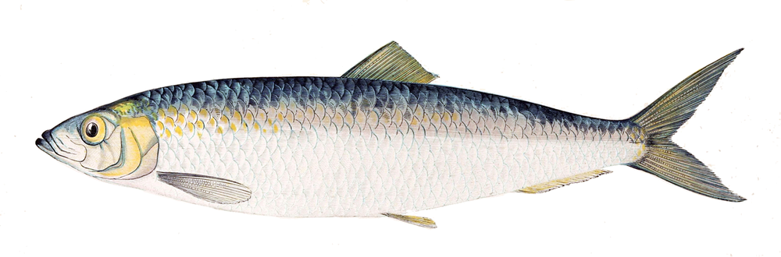

Notes:
Point about code bloat and platforms
… so you add all those features to your app
its streamlined, fast, shiny and cool
lets call him
ColdFusion, JRun, Flask, ASP.net, RubyOnRails
Homegrown
now you create one with each new framework
… time passes by

Slide 52
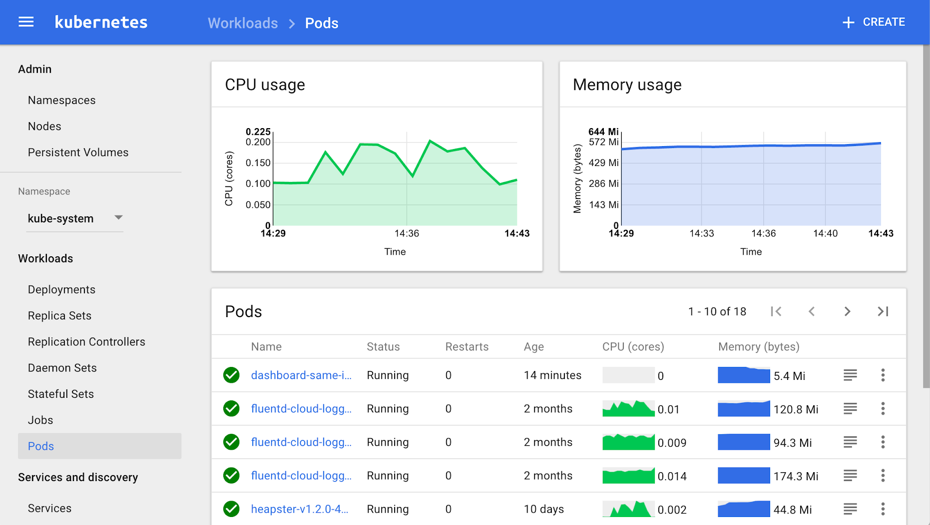
Notes:
This is the default view of monitoring in Kubernetes.
This is useful but not particularly informative
If you click the ‘services’ tab
You get a list of services but no information about their interactions
Hard to use this to manage to SLOs

Slide 53
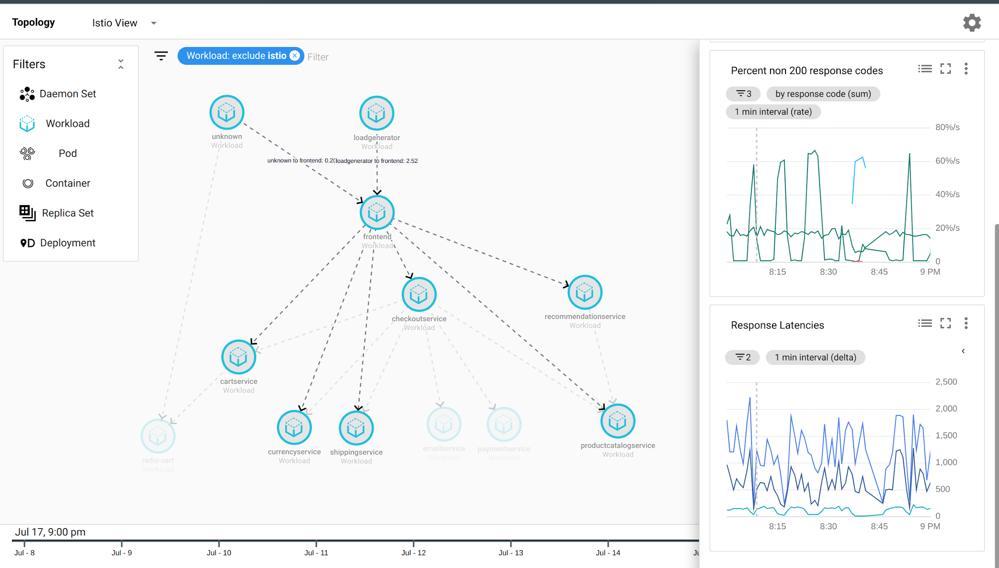
Notes:
This is the default view of monitoring in Kubernetes.
This is useful but not particularly informative
If you click the ‘services’ tab
You get a list of services but no information about their interactions

Slide 54



Istio Architecture
Service A
HTTP/1.1, HTTP/2, gRPC or TCP -- with or without mTLS
Service B
Pilot: Control plane to configure and push service communication policies.
Envoy: Network proxy to intercept communication and apply policies.
Mixer: Policy enforcement with a flexible plugin model for providers for a policy.
Citadel: Service-to-service auth[n,z] using mutual TLS, with built-in identity and credential management.
proxy
proxy
Policy checks, telemetry
Config data to Envoys
TLS certs to Envoys
Pilot
Mixer
Citadel
Control Plane API
Notes:
Sidecar proxies per microservice to handle ingress/egress traffic between services in the cluster and from a service to external services. The proxies form a secure microservice mesh providing a rich set of functions like discovery, rich layer-7 routing, circuit breakers, policy enforcement and telemetry recording/reporting functions.

Slide 55
Resiliency
Istio adds fault tolerance to your application without any changes to code
Resilience features
Timeouts
Retries with timeout budget
Circuit breakers
Health checks
AZ-aware load balancing w/ automatic failover
Control connection pool size and request load
Systematic fault injection
// Circuit breakers
destination: serviceB.example.cluster.local policy: - tags: version: v1 circuitBreaker: simpleCb: maxConnections: 100 httpMaxRequests: 1000 httpMaxRequestsPerConnection: 10 httpConsecutiveErrors: 7 sleepWindow: 15m httpDetectionInterval: 5m
Notes:
In our experience working with a diverse set of clients, 95% of them are happy with an out of process sidecar implementing all the resiliency features such as circuit breakers instead of having to build them into the application code.
Secondly, in most of the cases, there is a fair amount of parameter tweaking - e.g., making sure that timeouts across services are not too tight or ensuring that a circuit doesn’t open too early.
Istio provides dynamically configurable resilience features that you can tweak at runtime, *in production*.

Slide 56
Resiliency Testing
Systematic fault injection to identify weaknesses in failure recovery policies
HTTP/gRPC error codes
Delay injection
Timeout: 100ms
Retries: 3
300ms
Timeout: 200ms
Retries: 2
400ms
Envoy
Envoy
Envoy
svcA
svcB
svcC
Service A
Service B
Service C
Notes:
Systematic resilience testing allows you to test the ability of your services to recover from failures. You can isolate failures to specific subset of requests (such as those coming from QA teams), while running these tests in production.
If you recall the excellent Linkerd talk that Oliver gave this morning, he talked about a scenario where a chain of service calls had incompatible timeouts and retries. Well, you can always recover from these issues by using timeouts/retries/circuit breakers on the very first service in the call chain. But think of all the wasted work in the backend services (resources being held up).
Worse yet, think of the impact on your users. For example, consider Netflix recommendations. When the system is running well, you get personalized recommendations. That is a “feature”. When the personalized recommendations system is down, Netflix falls back to “generic recommendations”. This is great as long as the outage is temporary. But what if this becomes the permanent user experience for weeks at a stretch, because some frontend system had a misconfigured timeout that caused it to prematurely terminate API calls to the recommendation engine.

Slide 57

Traffic Splitting
serviceB.example.cluster.local
// A simple traffic splitting rule
destination: serviceB.example.cluster.local
match: source: serviceA.example.cluster.local route: - tags: version: v1.5
env: us-prod
weight: 99
- tags: version: v2.0-alpha
env: us-staging
weight: 1
Rules API
Pod Labels:
version: v1.5
env: us-prod
Pilot
Traffic routing rules
Envoy
99%
Pod
Envoy
svcB
Service B
http://serviceB.example
1%
svcA
Envoy
Service A
svcB
Traffic control is decoupled from infrastructure scaling
Pod Labels:
version: v2.0-alpha, env:us-staging
Notes:
Traffic control is decoupled from infrastructure scaling - i.e., the proportion of traffic routed to a version is independent of number of instances supporting the version
You can program these traffic routing rules using istio on the fly using simple rules as shown in the slide. These rules get translated into low level Envoy configs. Envoy periodically fetches configs from the manager and updates its internal routing table. There are no hot restarts, no impact to existing traffic.
We call this tag based routing.

Slide 58
Traffic Steering
Service B
version: v1
Pod 1
// Content-based traffic steering rule
destination: serviceB.example.cluster.local match: httpHeaders: user-agent: regex: ^(.*?;)?(iPhone)(;.*)?$ precedence: 2 route: - tags: version: canary
Pod 2
svcA
Pod 3
svcB
Service A
Service B
version: v1
Pod 1
User-agent: *Android*
Pod 2
Pod 3
svcA
svcB
Service A
User-agent: *iPhone*
Content-based traffic steering
Pod 4
svcB’
version: canary
Notes:
Content-based traffic steering - The content of a request can be used to determine the destination of a request
Another way to route requests is the age old method. Look at the contents of a request and route it to a specific set of instances. This opens up all sorts of possibilities. For a user facing service, you could route a portion of mobile traffic from a particular device, say an iPhone, to a specific version of the service. For internal services, callers would have the ability to explicitly request a particular version of the service. In fact, Verizon is using this particular technique in production today.

Slide 59
“What’s the life of a request?”

Slide 60
Service A
Service B
Service A comes up. Envoy is deployed with it and fetches service information, routing and configuration policy from Pilot. If Citadel is being used, TLS certs are securely distributed as well.
proxy
proxy
Routing and load balancing config to Envoys
TLS certs to Envoys
Pilot
Mixer
Citadel
Life of a request in the mesh

Slide 61
Service A
Service B
Service A places a call to service B.
Client-side Envoy intercepts the call.
Envoy consults config to know how/where to route call to service B (including any dynamic routing rules).
proxy
proxy
Pilot
Mixer
Citadel
Life of a request in the mesh

Slide 62
Service A
HTTP/1.1, HTTP/2, gRPC or TCP -- with or without mTLS
Service B
Envoy forwards request to appropriate instance of service B. There, the Envoy proxy deployed with the service intercepts the call.
proxy
proxy
Pilot
Mixer
Citadel
Life of a request in the mesh

Slide 63
Service A
Service B
Server-side Envoy checks with Mixer to validate that call should be allowed (ACL check, quota check, etc).
proxy
proxy
Policy checks, telemetry
Pilot
Mixer
Citadel
Life of a request in the mesh

Slide 64
Service A
Service B
Server-side Envoy forwards request to service B, which process request and returns response
proxy
proxy
Pilot
Mixer
Citadel
Life of a request in the mesh

Slide 65
Service A
Service B
Envoy forwards response to the original caller, where response is intercepted by Envoy on the caller side.
proxy
proxy
Pilot
Mixer
Citadel
Life of a request in the mesh

Slide 66
Service A
Service B
Envoy reports telemetry to Mixer (latency, response code, url, etc.)
proxy
proxy
Pilot
Mixer
Citadel
Logging adapter
Monitoring adapter
Life of a request in the mesh

Slide 67
Service A
Service B
Client-side Envoy forwards response to original caller.
proxy
proxy
Pilot
Mixer
Citadel
Life of a request in the mesh

Slide 68
Lab 3 Install Istio http://bit.ly/Kube18_servicemesh_vmw

Slide 69
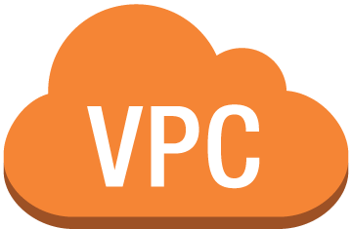

VMware Cloud PKS
Frontend Service
JavaScript Service
MySQL Service
Frontend Pod
Frontend Pod
App Pod
MySQL Pod
Namespace =planespotter
Kubernetes Cluster
Pod
Master Nodes
Worker Nodes
Service API
Load Balancer Service
virtual private cloud

Slide 70
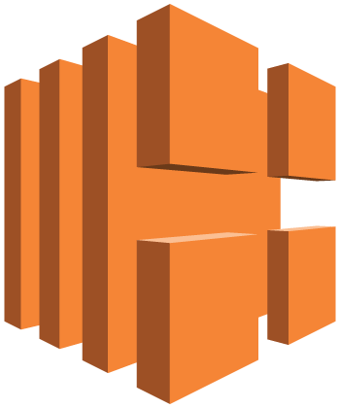
VMware Cloud PKS with Istio
Istio-ingress Gateway
Frontend Service
JavaScript Service
MySQL Service
Istio-pilot
Istio-citadel
Istio-ingress
Istio-Policy
Frontend Pod
Frontend Pod
App Pod
MySQL Pod
Istio-pilot
Istio-citadel
Istio-ingress
Istio-policy
Namespace =planespotter
Namespace =Istio-system
Kubernetes Cluster
Pod
Master Nodes
Worker Nodes
Service API
Load Balancer Service
virtual private cloud

Slide 71

Lunch is ready!
Please be back by 1 PM

Slide 72
Lab 4 : Configure Istio to manage app traffic http://bit.ly/Kube18_servicemesh_vmw

Slide 73
Planespotter Services
Index.html
registry.html
health.html
contacts.html
details.html

Slide 74
Publish app via Istio Gateway
Istio Ingress Gateway
Virtual Services
apiVersion: networking.istio.io/v1alpha3
kind: Gateway
metadata:
name: planespotter-gateway
spec:
selector:
istio: ingressgateway # use istio default controller
servers:
- port:
number: 80
name: http
protocol: HTTP
hosts:
- "*"
---
apiVersion: networking.istio.io/v1alpha3
kind: VirtualService
metadata:
name: planespotter
spec:
hosts:
- "*"
gateways:
- planespotter-gateway
http:
- match:
- uri:
exact: /index.html
- uri:
exact: /registry.html
- uri:
exact: /details.html
- uri:
exact: /health.html
- uri:
exact: /contact.html
route:
- destination:
host: planespotter-frontend
port:
number: 80

Slide 75
Ingest Sidecar Proxy into app
gateway: planespotter-frontend-ingress-gateway
Ingress: Istio-ingress-gateway
Planespotter Virtual Service
Planespotter-frontend-ingress-gateway
Istio-ingress Gateway
Service:planespotter-frontend
Frontend Service
JavaScript Service
MySQL Service
Pod:planespotter-frontend
Istio-pilot
Istio-citadel
Istio-ingress
Istio-Policy
Frontend Pod
App Pod
MySQL Pod
Istio-citadel
Istio-ingress
Frontend Pod
Envoy-Proxy
Envoy-Proxy
Envoy-Proxy
Envoy-Proxy
Istio-pilot
Istio-policy
Namespace = planespotter
Namespace =Istio-system
Kubernetes Cluster
Pod
Service API
Load Balancer Service

Slide 76
Istio Use cases

Slide 77
Lab 5 : Traffic Management http://bit.ly/Kube18_servicemesh_vmw

Slide 78
Istio Use case: Traffic Management
A/B Testing
80:20 Traffic
Rate Limiting

Slide 79
A/B test
2
1
3
Planespotter Virtual Service
Planespotter-frontend-ingress-gateway
Istio-ingress Gateway
Web Frontend Service
JavaScript Service
MySQL Service
Istio-pilot
Istio-citadel
Istio-ingress
Istio-Policy
4/5
4/5
App Pod
MySQL Pod
Frontend Pod
Istio-citadel
Istio-ingress
Frontend Pod
Envoy-Proxy
Envoy-Proxy
Envoy-Proxy
Envoy-Proxy
Istio-pilot
Istio-policy
Namespace = planespotter
Namespace =Istio-system
V1.1
Kubernetes Cluster
Pod
Master Nodes
Worker Nodes
Service API
Load Balancer Service
virtual private cloud

Slide 80
Considerations for A/B test
---
apiVersion: apps/v1beta1
kind: Deployment
metadata:
name: planespotter-frontend-v2
namespace: planespotter
labels:
app: planespotter-frontend
tier: frontend
spec:
replicas: 2
selector:
matchLabels:
app: planespotter-frontend
template:
metadata:
labels:
app: planespotter-frontend
tier: frontend
version: v2
The deployment should match the app-labels
The deployment should have version in meta-data

Slide 81
Lab 6: Canary Upgrades http://bit.ly/Kube18_servicemesh_vmw

Slide 82
Canary Upgrades with just Kubernetes
Load balancer /Ingress
Version 1
Version 2
app = frontend
app = frontend
8 replicas
2 replicas
Kubernetes Round robin traffic between pod
Instance management of individual pods in manual

Slide 83
Canary Upgrades with Istio
2
1
3
Destination Rules
Planespotter Virtual Service 80:20
Planespotter-frontend-ingress-gateway
Istio-ingress Gateway
Web Frontend Service
JavaScript Service
MySQL Service
Istio-pilot
Istio-citadel
Istio-ingress
Istio-Policy
4/5/6
7
App Pod
MySQL Pod
Frontend Pod
Istio-citadel
Istio-ingress
Frontend Pod
Envoy-Proxy
Envoy-Proxy
Envoy-Proxy
Envoy-Proxy
Istio-pilot
Istio-policy
Namespace = planespotter
Namespace =Istio-system
V1.1
Kubernetes Cluster
Pod
Master Nodes
Worker Nodes
Service API
Load Balancer Service
virtual private cloud

Slide 84
Considerations for Canary upgrade
apiVersion: networking.istio.io/v1alpha3
kind: VirtualService
metadata:
name: planespotter-frontend8020
spec:
hosts:
- planespotter-frontend
http:
- route:
- destination:
host: planespotter-frontend
subset: v2
weight: 20
- destination:
host: planespotter-frontend
subset: v1
weight: 80
New deployments should match app-labels with the older version
New deployment should have app-version

Slide 85
Lab 7: Distributed Tracing http://bit.ly/Kube18_servicemesh_vmw

Slide 86
Why Distributed Tracing?
How to root-cause with a distributed system?
Logs and Metrics only give point in time data
How to co-relate data from multiple services?
No re-writing application code to collect trace information

Slide 87
More usecases for Istio to expolore
Manage TLS between services
Manage what application to show to specific users based on cookies etc.
Egress traffic management
Hybrid management with containers and Virtual Machines
Multi cluster Management

Slide 88
Thank you!
Please fill out the Survey!
http://bit.ly/feed_sm

